Slide 1



Validated Problem
CipherStorm: Reality-Lag Secured Commerce
Sophisticated cyberattacks on e-commerce systems target API vulnerabilities, fake payments, DDoS attacks, and insider threats.
Enterprises spend millions on security infrastructures
Once attackers breach a layer, systems crash instantly
"We don't just block hackers — we make them live inside our illusion while the real system heals and learns."
Security tools fail to capture attacker behavior
Real System
Shadow System
Team Name: CipherStorm | CIEL Kingston | vibeAIthon 2025
Safe, protected, self-healing
Illusion, monitoring, learning

Slide 2











Prototype Overview
Prototype Name
Dual-Timeline Adaptive Security Architecture
Reality-Lag Secured Commerce (RLS-Ecom)
Core Innovation
Anomaly Detection Engine
Segregation Layer
Shadow Timeline Generator
Adaptive deception + self-healing architecture embedded in realistic commerce workflow
Routes users to real or shadow
Monitors user behavior patterns
Creates fake environment
Technology Stack
React.js
TailwindCSS
Node.js
Python ML
PostgreSQL
Redis
TensorFlow
Chart.js
Multi-Shadow Manager
Reverse Engineering
Self-Healing Core
Auto-recovers system
Docker
Manages recursive illusions
Extracts attack patterns
Fully Functional | Clickable Interface | Real-Time Simulation
Security Dashboard
Visualizes threats

Slide 3












User Experience & Impact
Unique & Innovative Aspects
User Journey
Multi-Shadow Illusion
1
Visit & Browse
Recursive environment that keeps attackers trapped in evolving layers
User browses products, adds to cart, proceeds to checkout
Self-Healing Engine
2
Anomaly Detection
Auto-restores data integrity while attacker is still busy
Suspicion score exceeds threshold → User moved to Shadow Timeline
Reverse Engineering Capture
3
Shadow Experience
Turns attacks into valuable learning datasets
Fake prices, orders, dashboards → All actions logged for analysis
Adaptive Deception
Attackers can't fingerprint fake systems — responses change dynamically
4
Real System Healing
Self-healing core rolls back/patches affected areas
Impact Metrics
Reduces server stress by 40-50%
Lowers breach recovery costs drastically
Real Timeline
Shadow Timeline
Creates real-time attacker intelligence repository
Makes cybersecurity proactive and self-evolving
Safe, protected, zero disturbance
Illusion, monitoring, learning

Slide 4
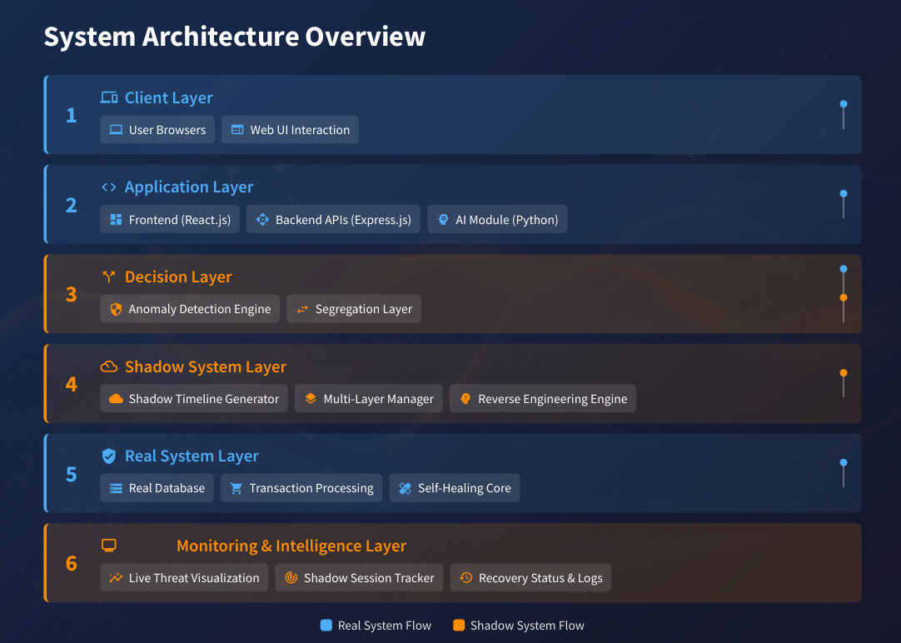

Slide 5
Wireframes and Screenshots
Shopping
attack
deception
intelligence
healing
Wireframe in Figma – Click Here

Slide 6
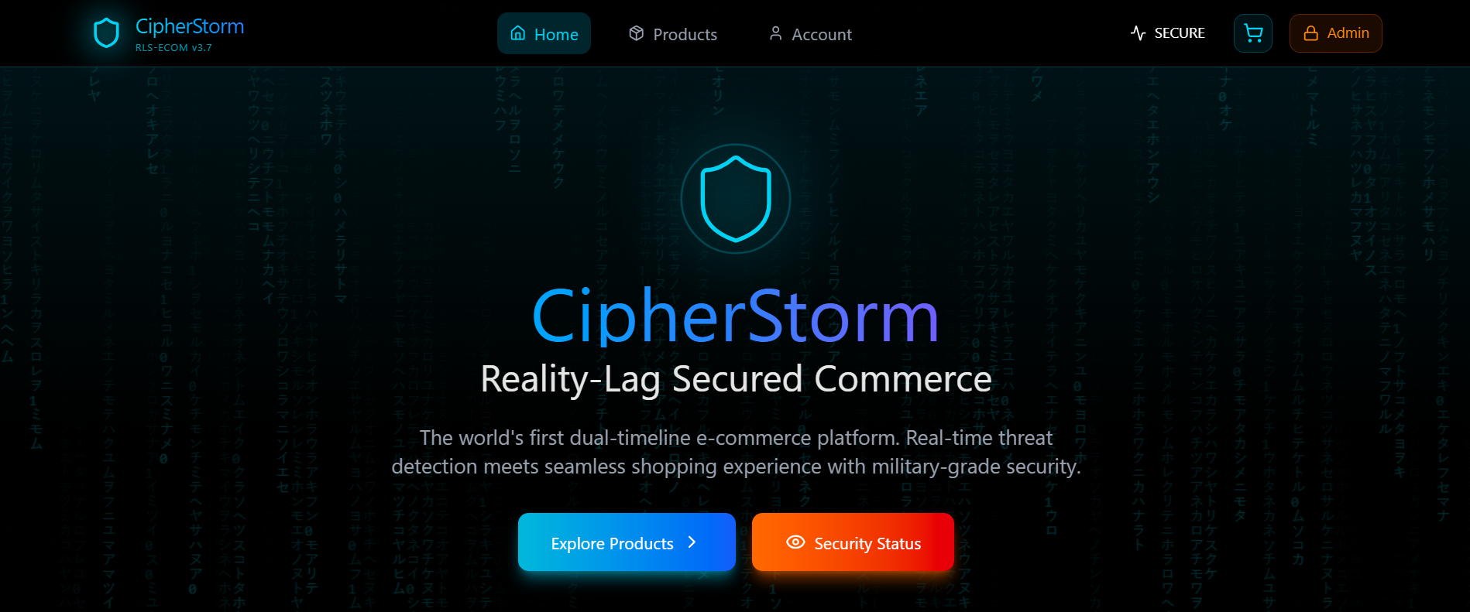

Slide 7
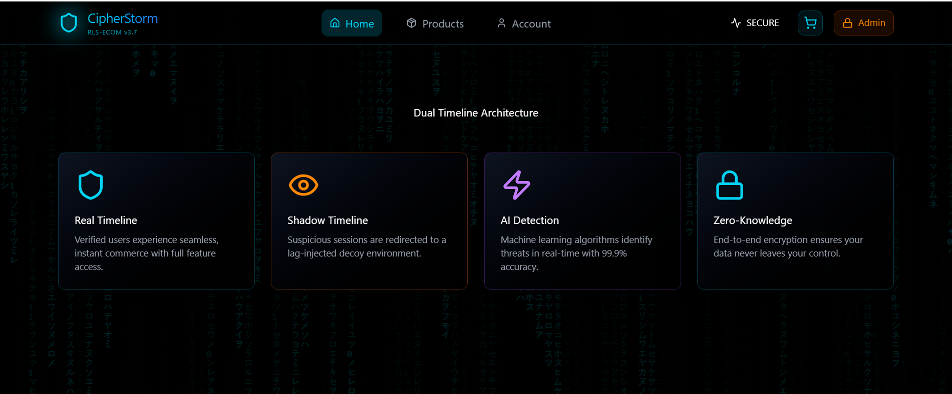

Slide 8
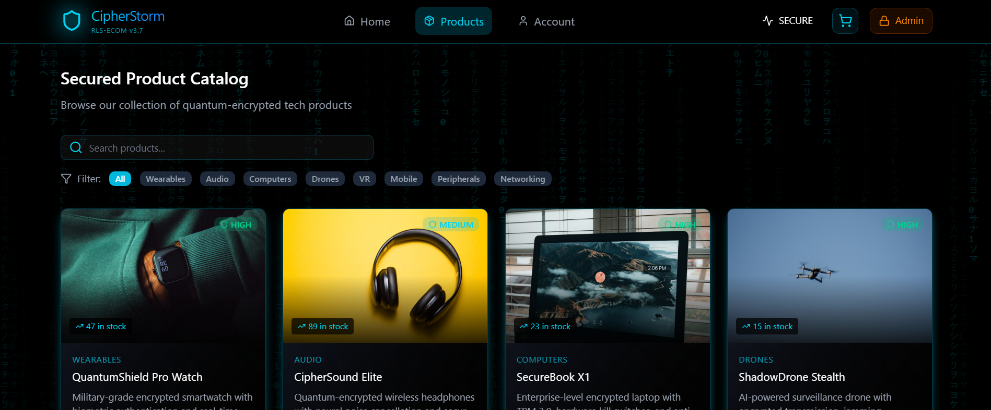

Slide 9
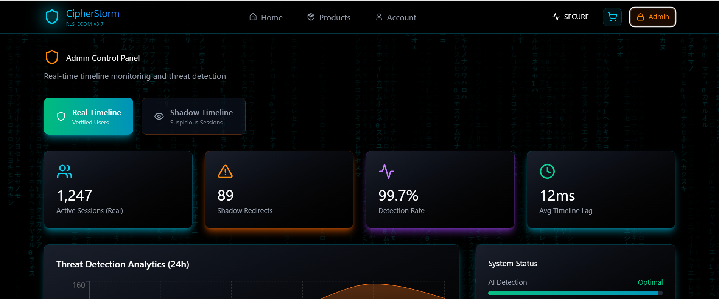

Slide 10
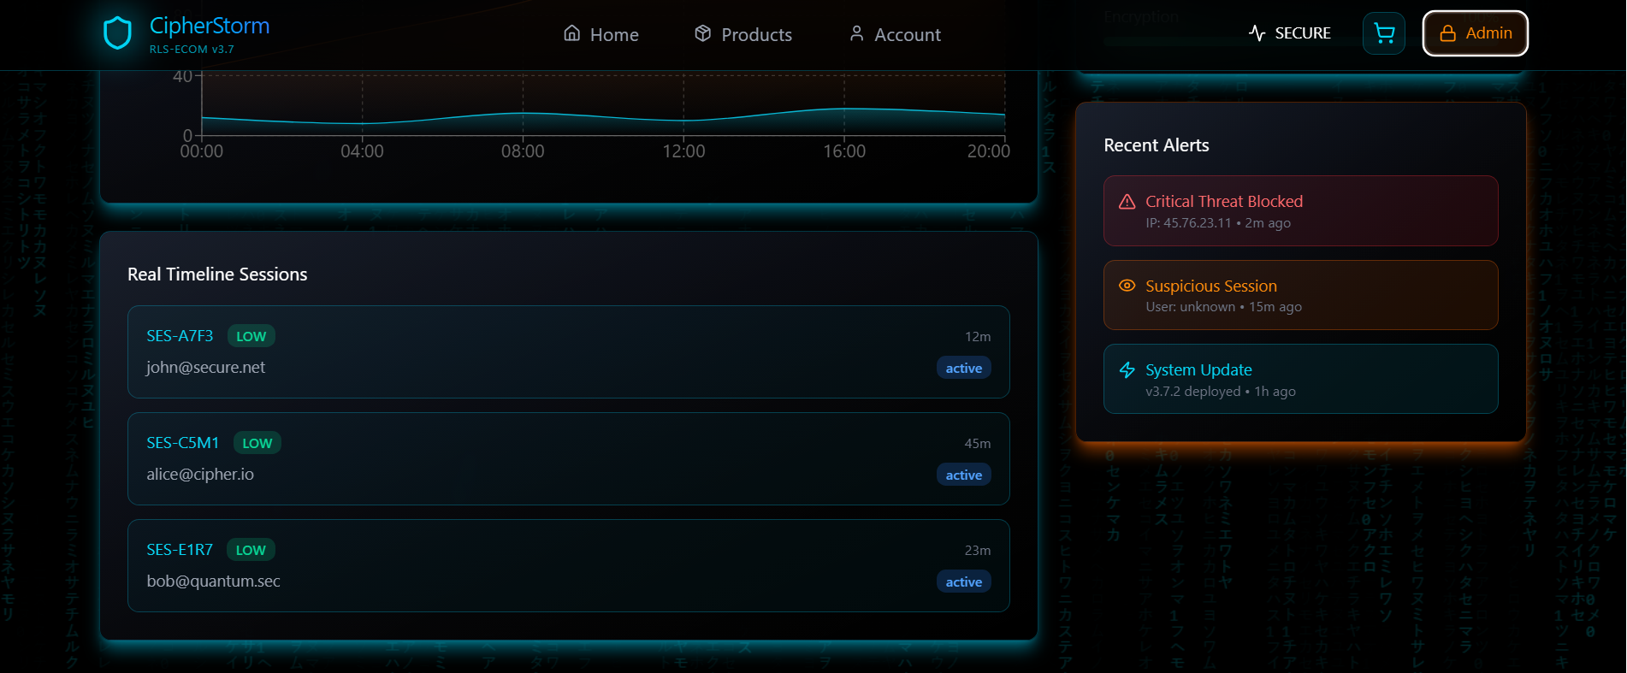

Slide 11
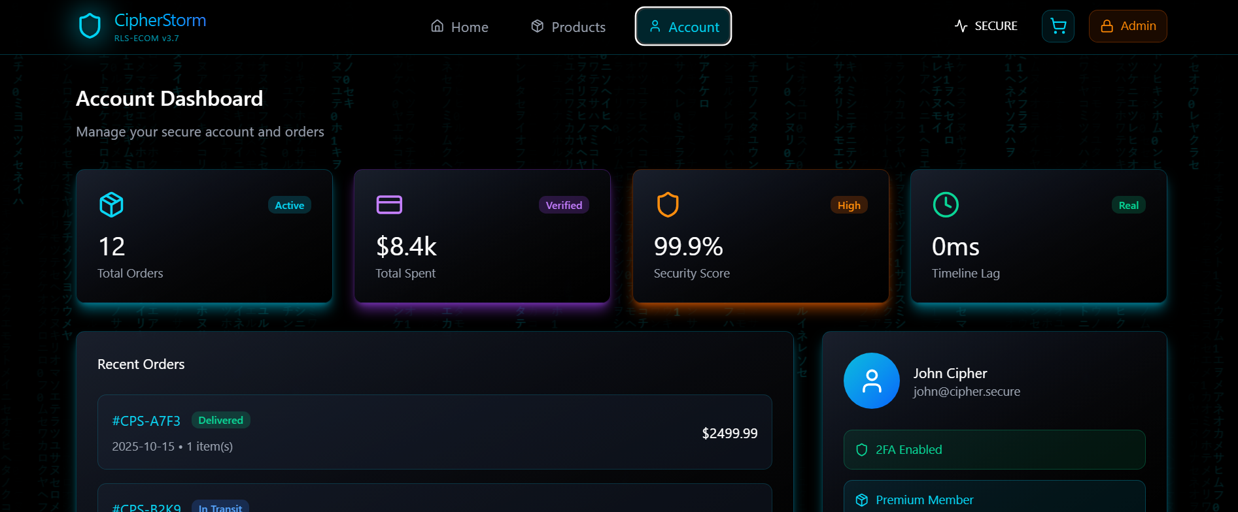

Slide 12










Team CipherStorm
Five innovators. One storm. Redefining cybersecurity through deception and perception.
Surya P
Shakthi Sri T S
Full-Stack Developer & System Integrator
Project Lead & AI Architect
Real-time web ecosystem builder
Founded Reality-Lag Security concept
Segregation Layer integration
Dual-timeline architecture design
Traffic rerouting modules
ML-driven anomaly detection
End-to-end system orchestration
Adaptive deception orchestration
Gayathri M
Security Automation Engineer
Pooja A
Self-Healing Core implementation
Research & Cyber Forensics Specialist
Snapshot and rollback logic
Real-time patching automation
Modern attack pattern analysis
Timeline synchronization control
Reverse Engineering Engine design
Payload capture and analysis
Gomathi M P
Ethical defense mechanisms
UI/UX Designer & Visualization Analyst
Security Dashboard design
Ultra-realistic shadow interfacesa
Attack movement visualization
Deception analytics display
"CipherStorm – Where Illusion Meets Intelligence."
We don't block attacks — we rewrite reality.

Slide 13
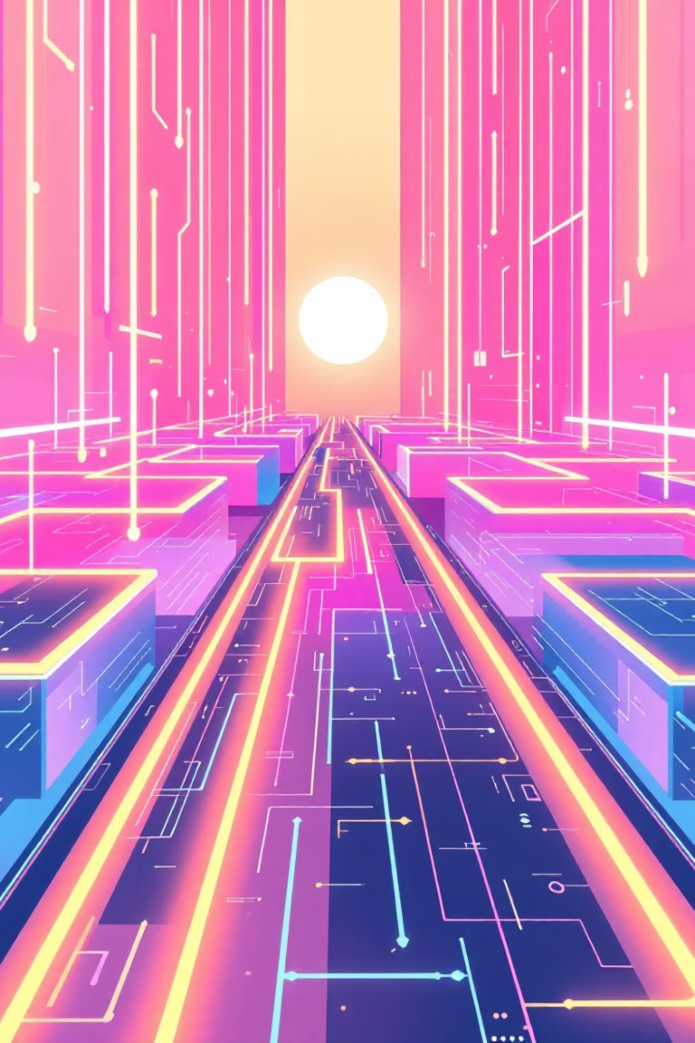




The Ask
Mentorship
Guidance from cybersecurity researchers at IITM to refine our approach.
Infrastructure Support
Cloud resources for full-scale prototype testing and validation.
Enterprise Partnerships
Collaborate with organizations to pilot our solution in real-world scenarios.
Expert Feedback
Insights from cybersecurity professionals on expanding to global scalability.
Our Vision
To redefine digital defense through perception control—so attackers don't just fail…
they get lost inside our illusion.

Slide 14
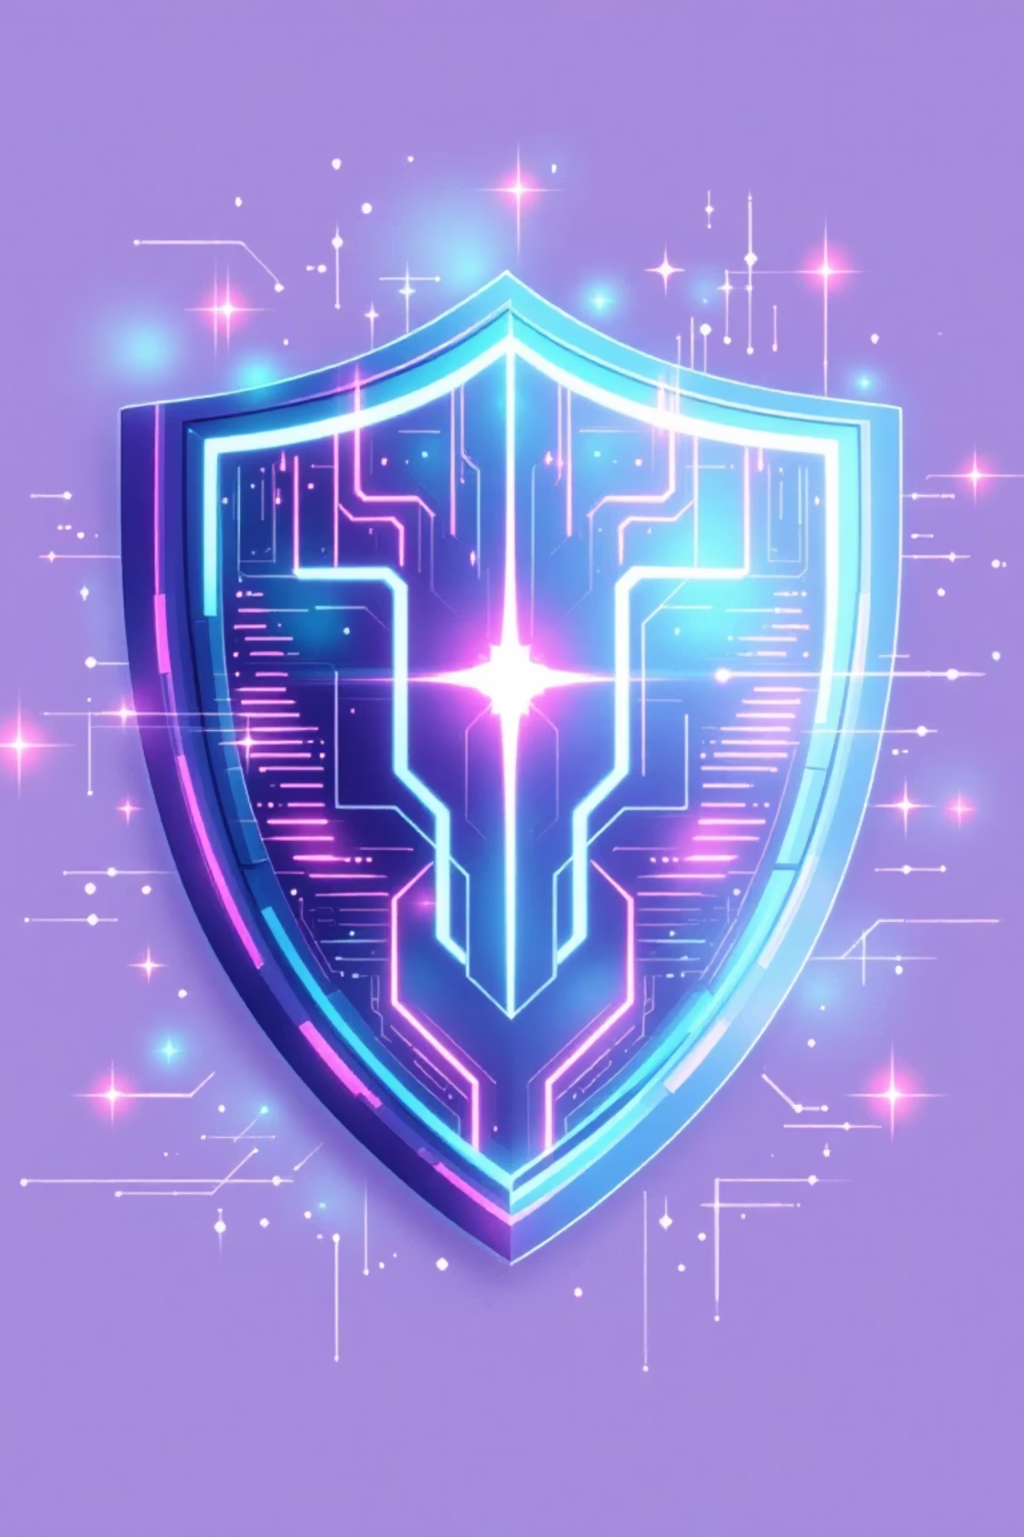
Reality-Lag Security
A dual-timeline defense architecture that doesn't just block cyberattacks—it manipulates, deceives, and heals.
Thank You

